Slide 1
Thank you for the opportunity to present to you today.
Notes:
Thank you very much for giving us this opportunity to talk to you today.
CLICK, CLICK

Slide 2
Circumstances contributing to membership decline:
Covid 19
Drop in Business Activator hours
Closure or financial uncertainty of businesses
(Only 5 businesses said they did not want to renew)
Notes:
2020 saw a decline in membership numbers by 27%
Contributing factors were Covid 19, drop in the Business Activator hours and the closure or financial uncertainty from many local businesses.
Whilst we are starting this presentation on a low note regarding membership numbers Business Whangaparaoa feel, under the circumstances in 2020, we have had a very successful year.
Here’s what we’ve been up to …

Slide 3
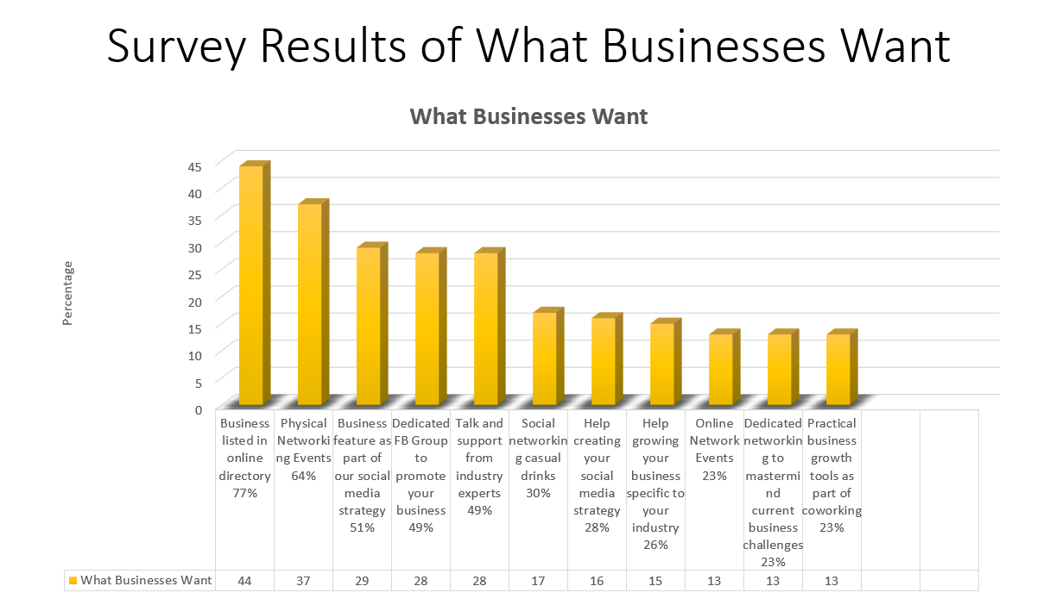
2020 Strategic and Membership Planning
At a Strategic Planning meeting on 31 January 2020 a plan was formulated for events and membership growth in 2020 based around 2019 surveys and response to activities
Notes:
At a Strategic Planning meeting on 31 January 2020 a plan was formulated for events and membership growth in 2020 based around 2019 surveys and response to activities

Slide 4
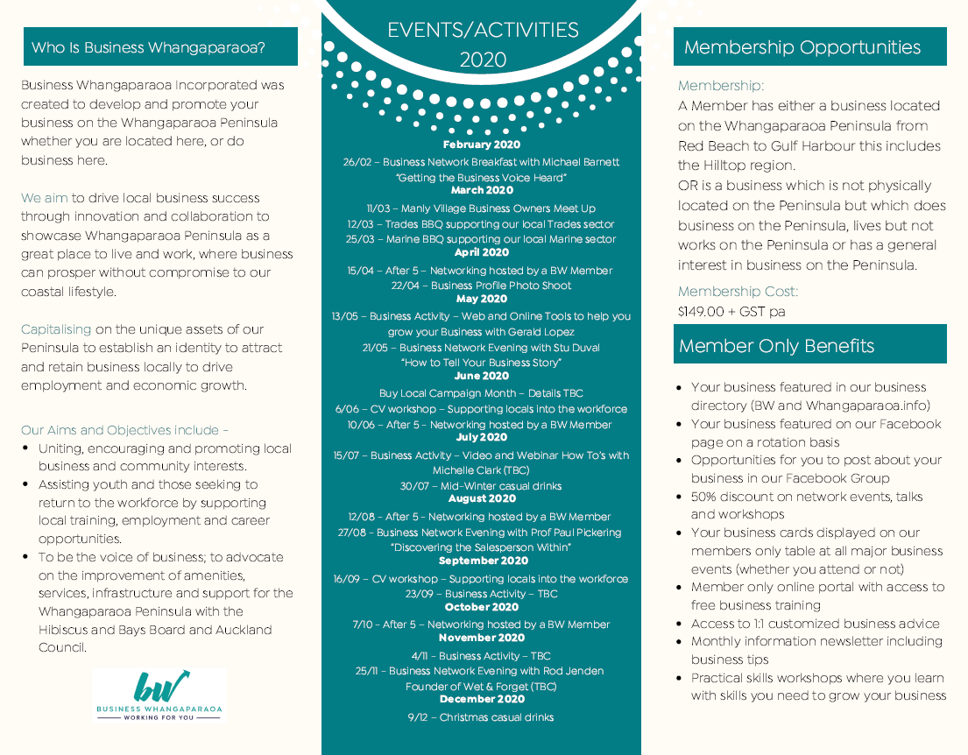
Business Whangaparaoa 2020 In Review
Hence we started the year with a packed calendar of events!
Our brochure released at the
first network event of the year
Notes:
Hence we started the year with a packed calendar of events!
Our brochure released at the first network event of the year

Slide 5
We started the annual events with a breakfast co-hosted with
Destination Orewa and Silverdale Business Association
Notes:
We started the annual events with a breakfast co-hosted with Destination Orewa and Silverdale Business Association

Slide 6
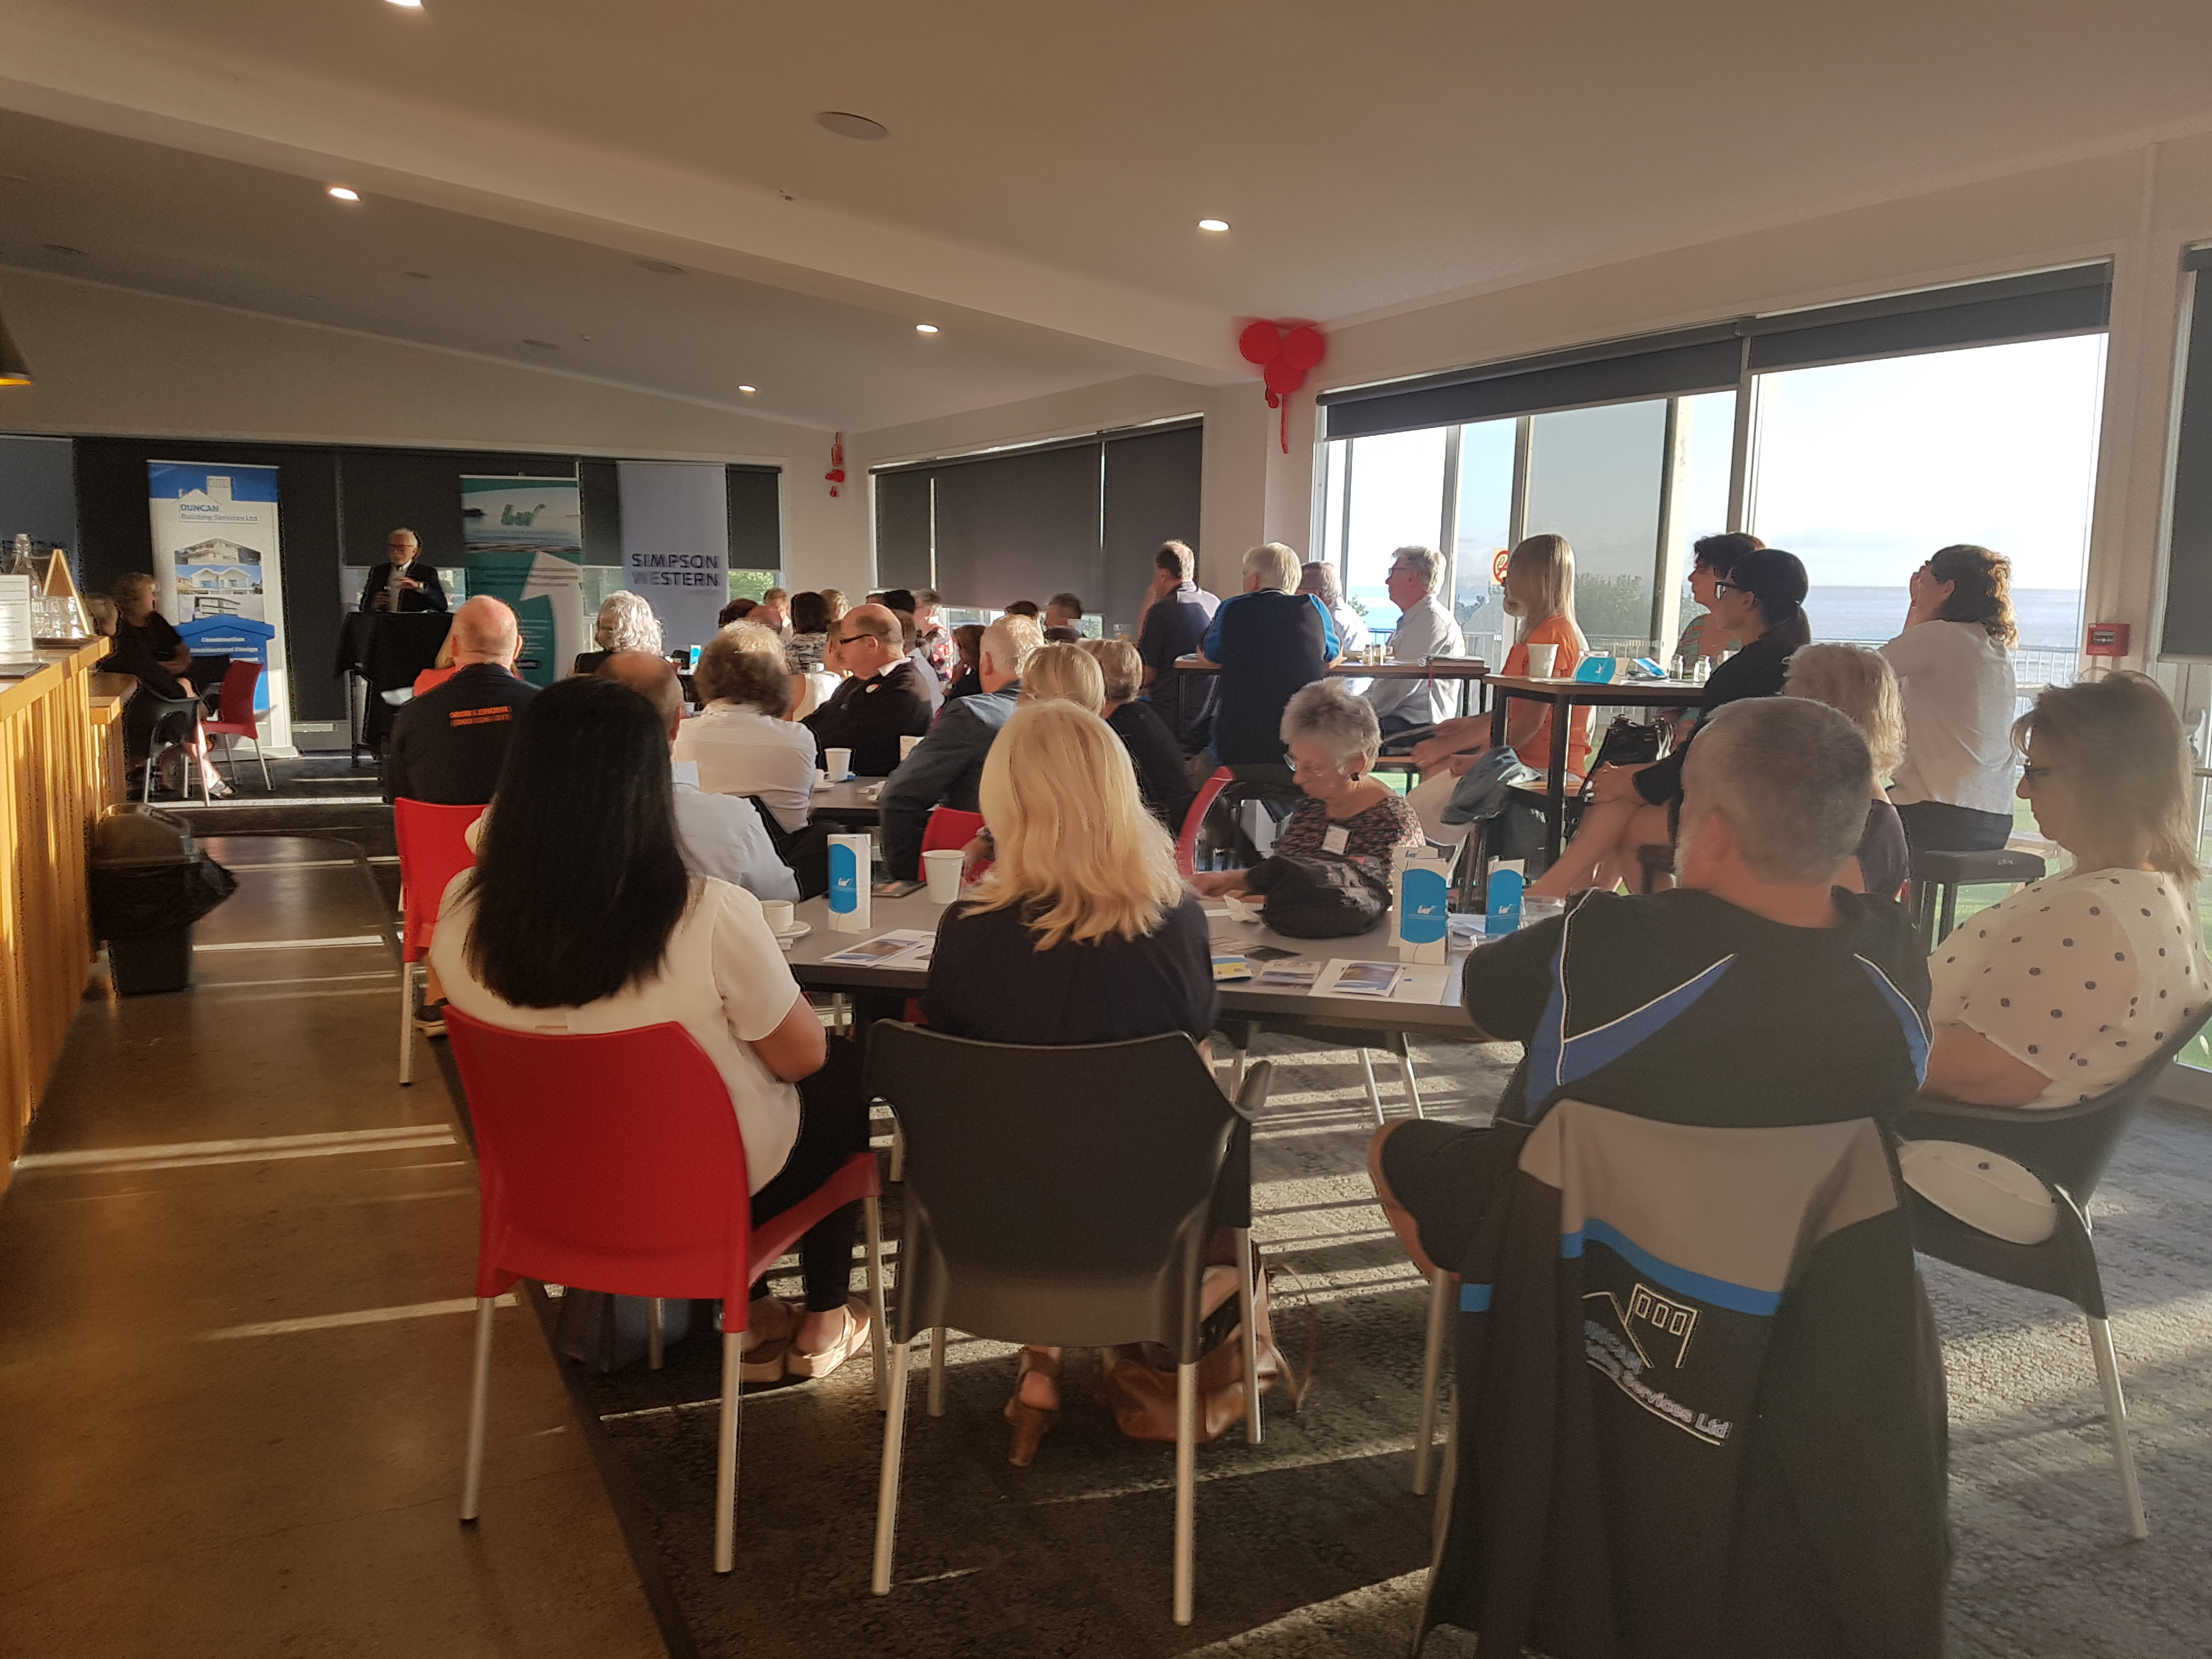
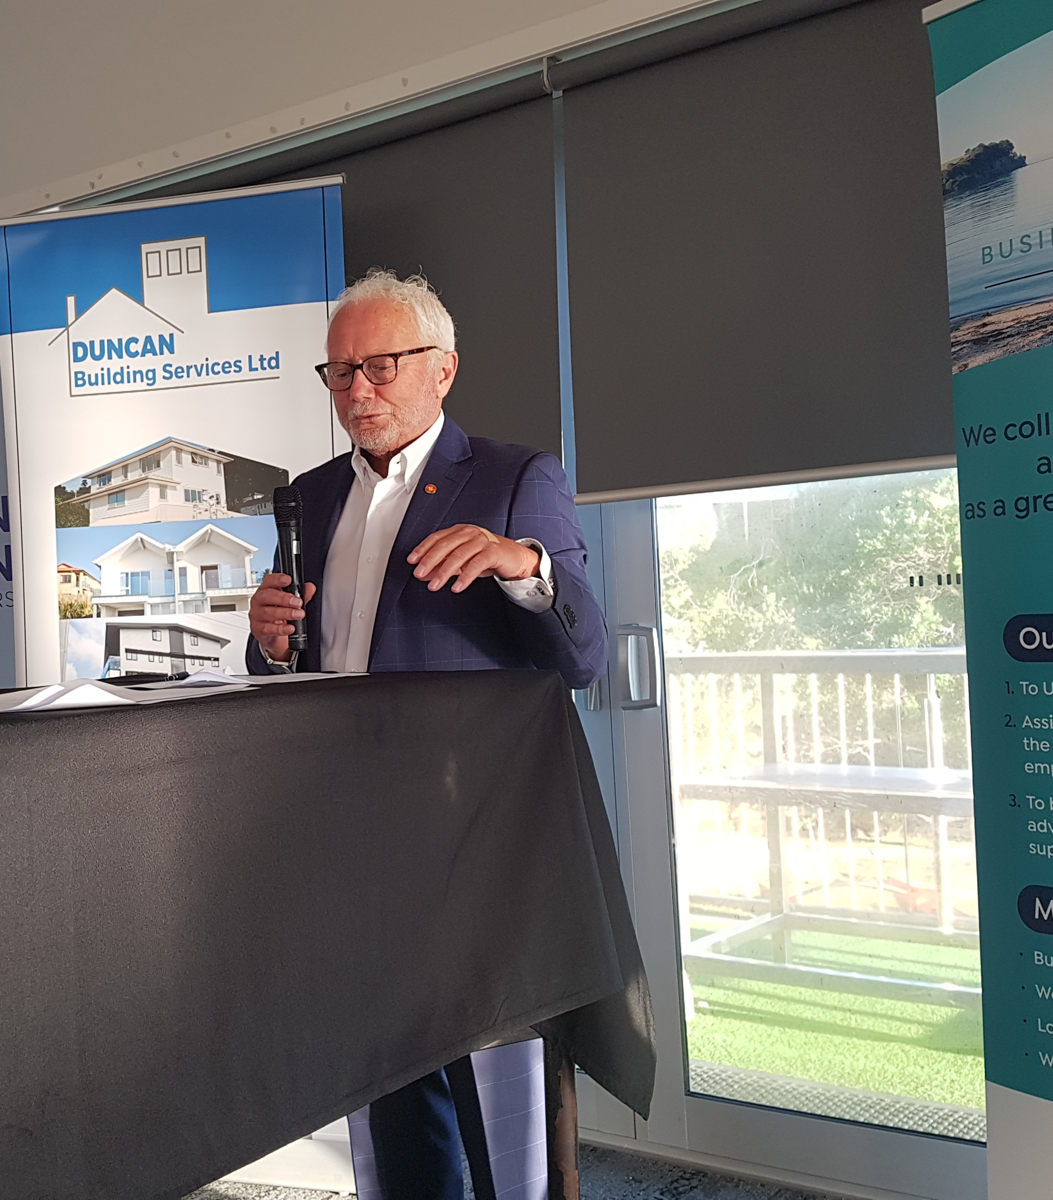
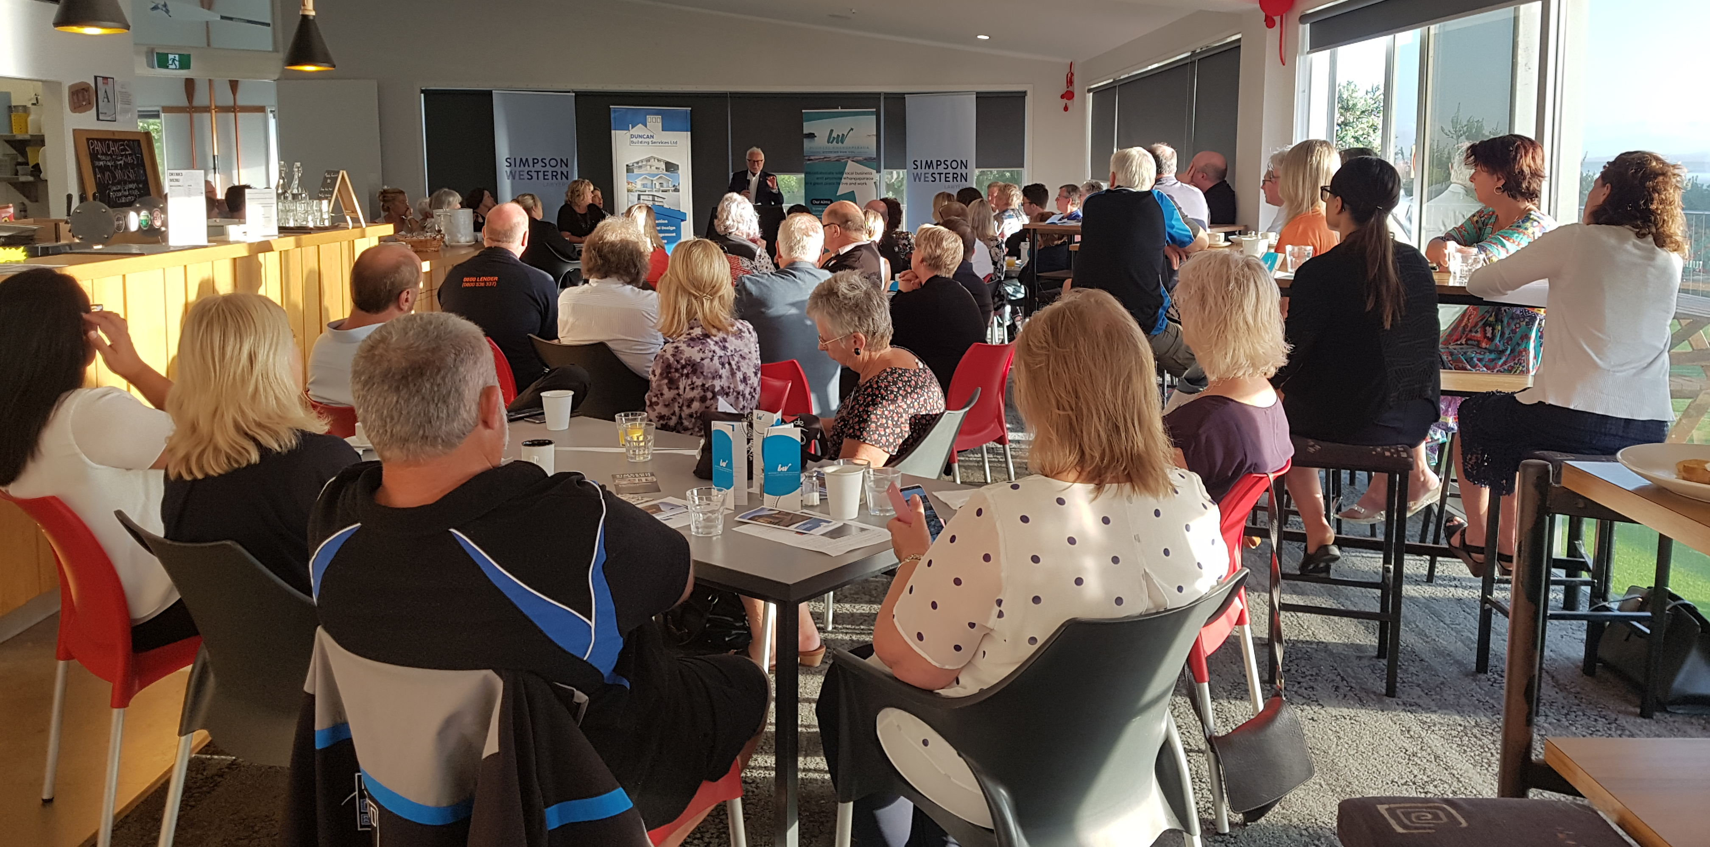
Good turn out with
58 attendees
Notes:
Good turn out with 58 attendees

Slide 7
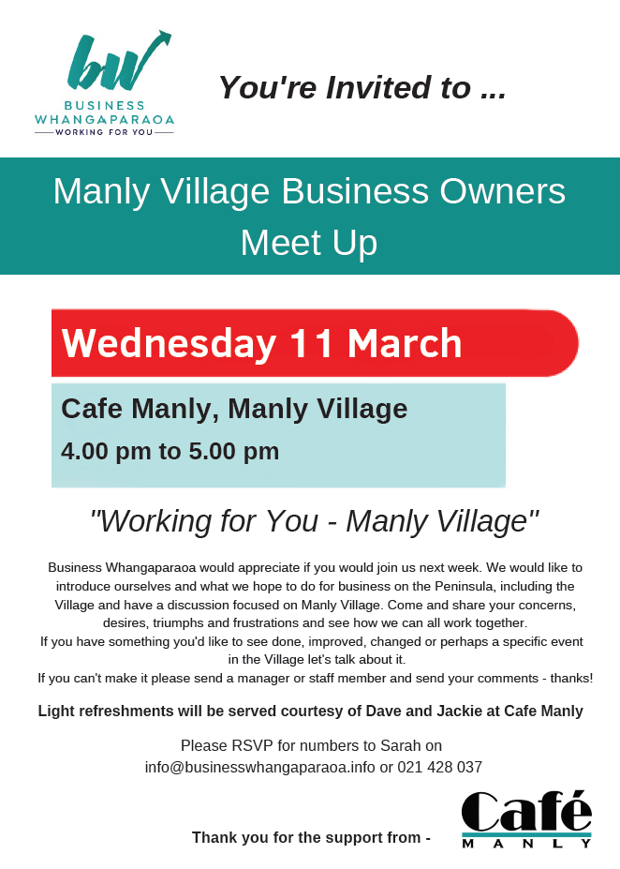
Early 2020 we were granted a Local Board Quick Response Grant for $2,000 in order to activate events seeking input from industry sectors so we can deliver what they need.
We met, very successfully, with the Manly Village business owners.
Notes:
Early 2020 we were granted a Local Board Quick Response Grant for $2,000 in order to activate events seeking input from industry sectors so we can deliver what they need.
We met, very successfully, with the Manly Village business owners.

Slide 8
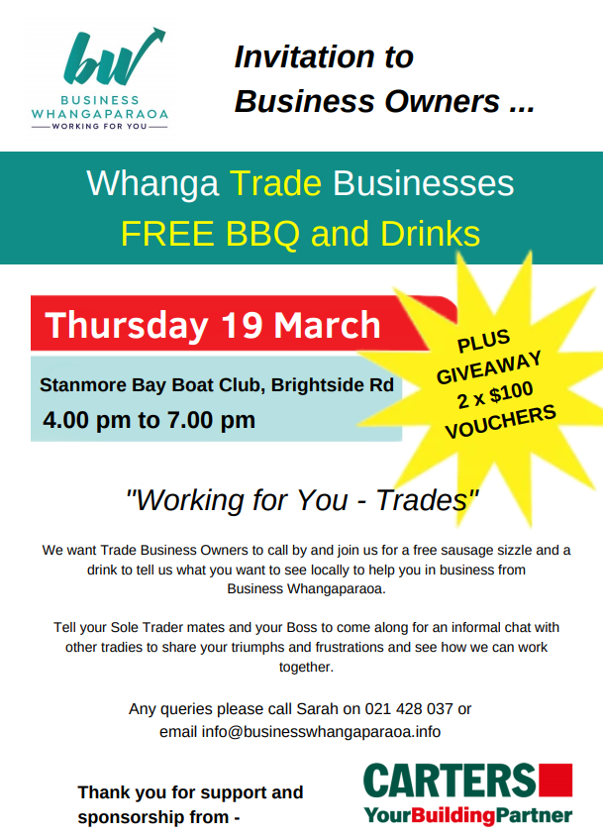
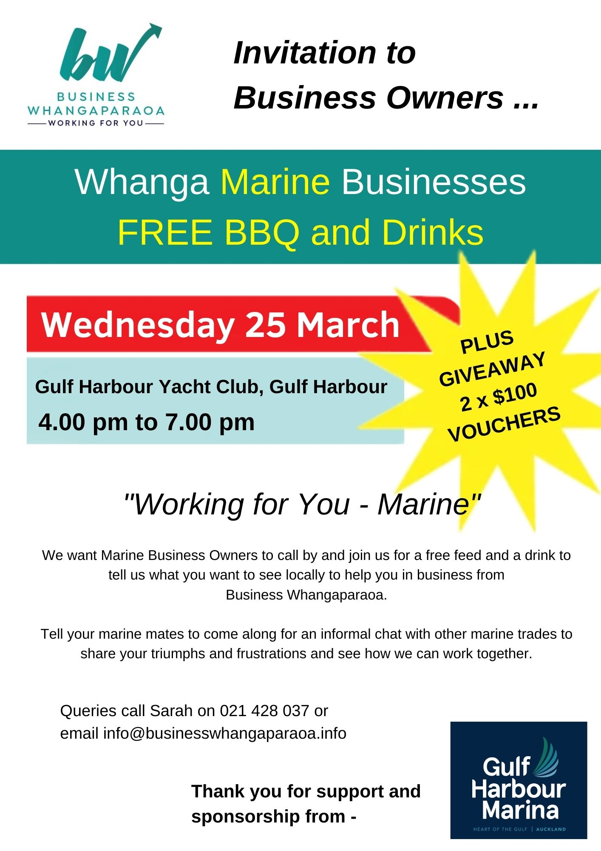
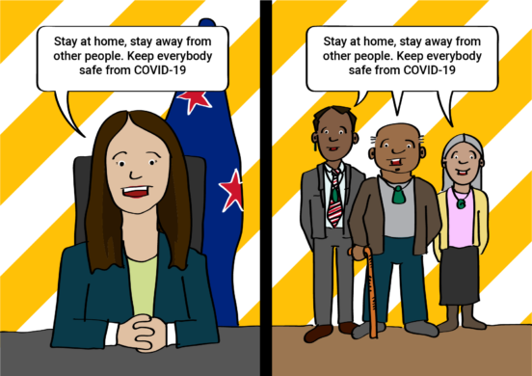
POSTPONED
We also planned events to seek input from Trades and Marine businesses.
However Covid 19 struck and both our Trade and Marine events, scheduled 19 and 25 March, were postponed
Notes:
We also planned events to seek input from Trades and Marine businesses.
However Covid 19 struck and both our Trade and Marine events, scheduled 19 and 25 March, were postponed

Slide 9
As we pulled out of lockdown we applied for change of use of our Quick Response Funds towards a Buy Local Campaign to be run alongside Destination Orewa and Silverdale Business
Stats
No of entries | 251
Amount spent and registered locally | $21,263.15
No of stores | 110
Location of stores
Whangaparaoa | 133
Orewa | 39
Silverdale | 79
This ran 20 May to 20 June and was very successful
Notes:
As we pulled out of lockdown we applied for change of use of our Quick Response Funds towards a Buy Local Campaign to be run alongside Destination Orewa and Silverdale Business
This ran 20 May to 20 June and was very successful

Slide 10
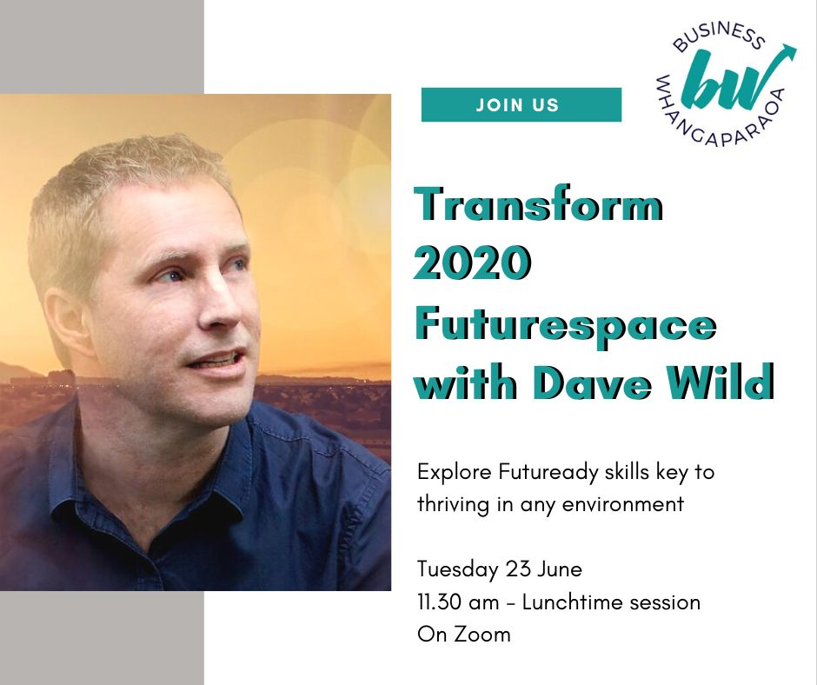
And as our committee came to terms with Zoom we both continued meeting and supporting local online workshops and learning
Notes:
And as our committee came to terms with Zoom we both continued meeting and supporting local online workshops and learning

Slide 11
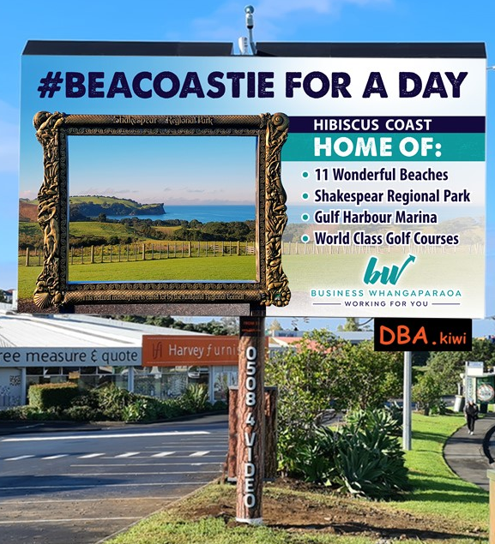
#BEACOASTIE FOR A DAY
In May and June we also took advantage of a free opportunity for a rotating billboard at Wairau Road, North Shore to promote Business Whangaparaoa and the Coast as a great destination.
Notes:
In May and June we also took advantage of a free opportunity for a rotating billboard at Wairau Road, North Shore to promote Business Whangaparaoa and the Coast as a great destination.
#BeACoastie for a day

Slide 12
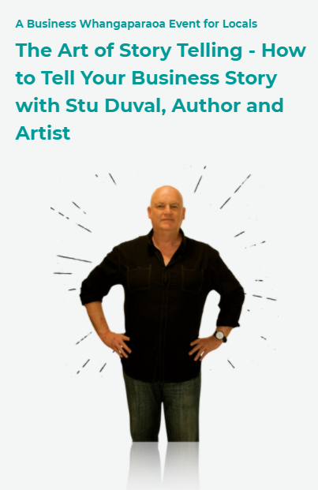
Our Network event planned for 26 May was postponed for a few weeks with there still a reluctance for people to “mingle”
Further tragedy struck this event with sad passing of Stu’s son in early June and the departure of our Business Activator unexpectedly to the UK.
It was postponed indefinitely at this stage.
Notes:
Our Network event planned for 26 May was postponed for a few weeks with there still a reluctance for people to “mingle”
Further tragedy struck this event with sad passing of Stu’s son in early June and the departure of our Business Activator unexpectedly to the UK.
It was postponed indefinitely at this stage.

Slide 13
Two events that did go ahead were successful mid-year and end of year Christmas casual networking and drinks! Yay!!
Notes:
Two events that did go ahead were successful mid-year and end of year Christmas casual networking and drinks! Yay!!

Slide 14
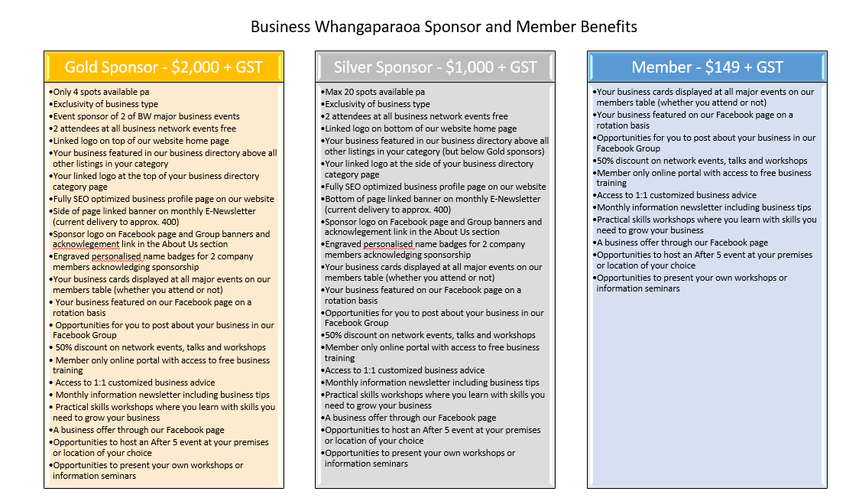
In April, as Memberships came up for renewal, it was decided, in a bid to retain members we would offer membership fees could be paid in 2 instalments over the year.
After some (expected) membership losses at end of July we held a Membership meeting to discuss potential growth and strategy going forward. We also finally formulated our Sponsor plan.
Notes:
In April, as Memberships came up for renewal, it was decided, in a bid to retain members we would offer membership fees could be paid in 2 instalments over the year.
After some (expected) membership losses at end of July we held a Membership meeting to discuss potential growth and strategy going forward. We also finally formulated our Sponsor plan.

Slide 15
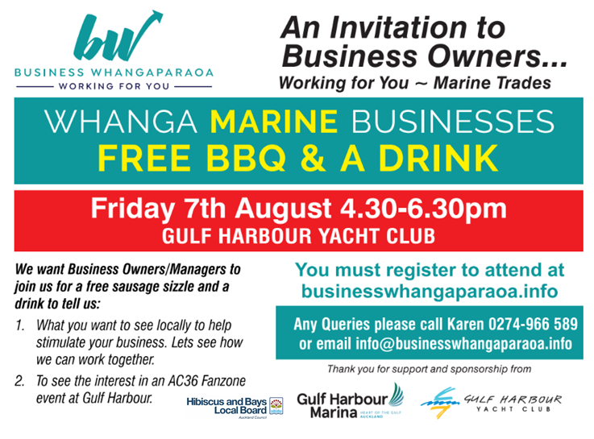
We also managed to reschedule our Marine BBQ. Out of which a potential end of year Marine Market could evolve.
Notes:
We also managed to reschedule our Marine BBQ. Out of which a potential end of year Marine Market could evolve.

Slide 16
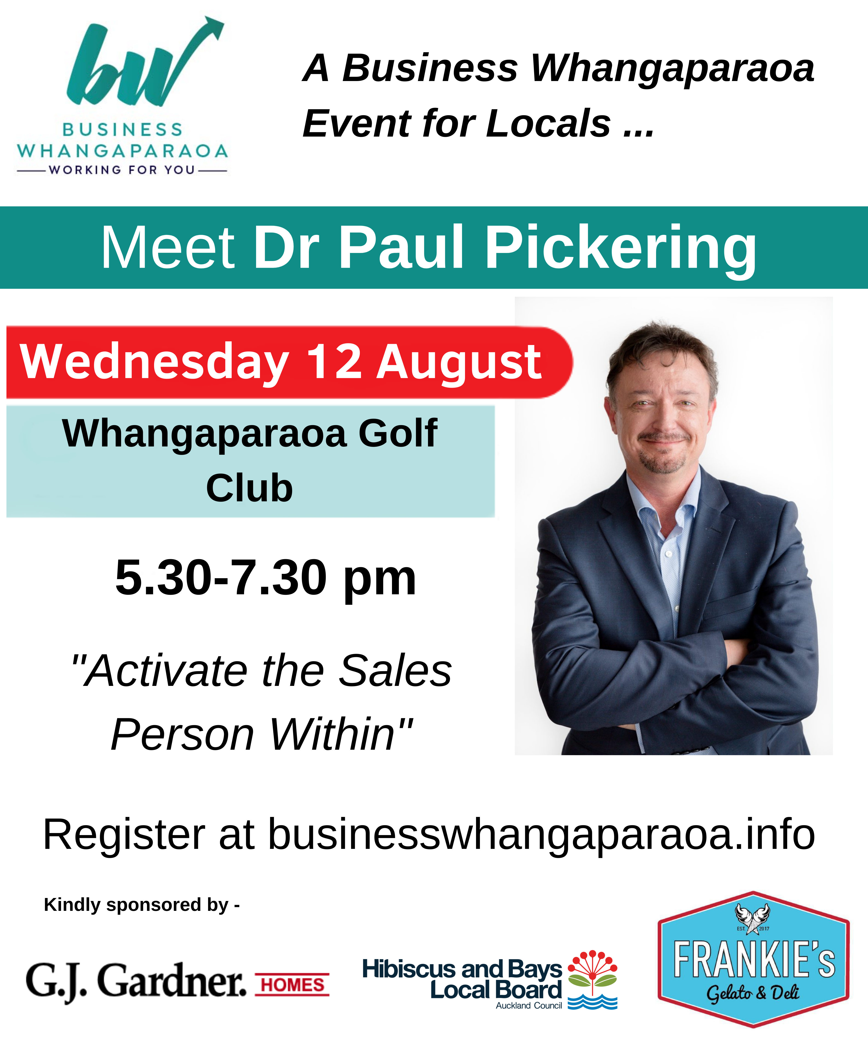
With Covid restrictions lifted and businesses keen to get out we continued on schedule for our August network event.
However unfortunately NZ was thrown back into lockdown the day before the scheduled event hence a further postponement.
Postponed
Notes:
With Covid restrictions lifted and businesses keen to get out we continued on schedule for our August network event.
However unfortunately NZ was thrown back into lockdown the day before the scheduled event hence a further postponement.

Slide 17
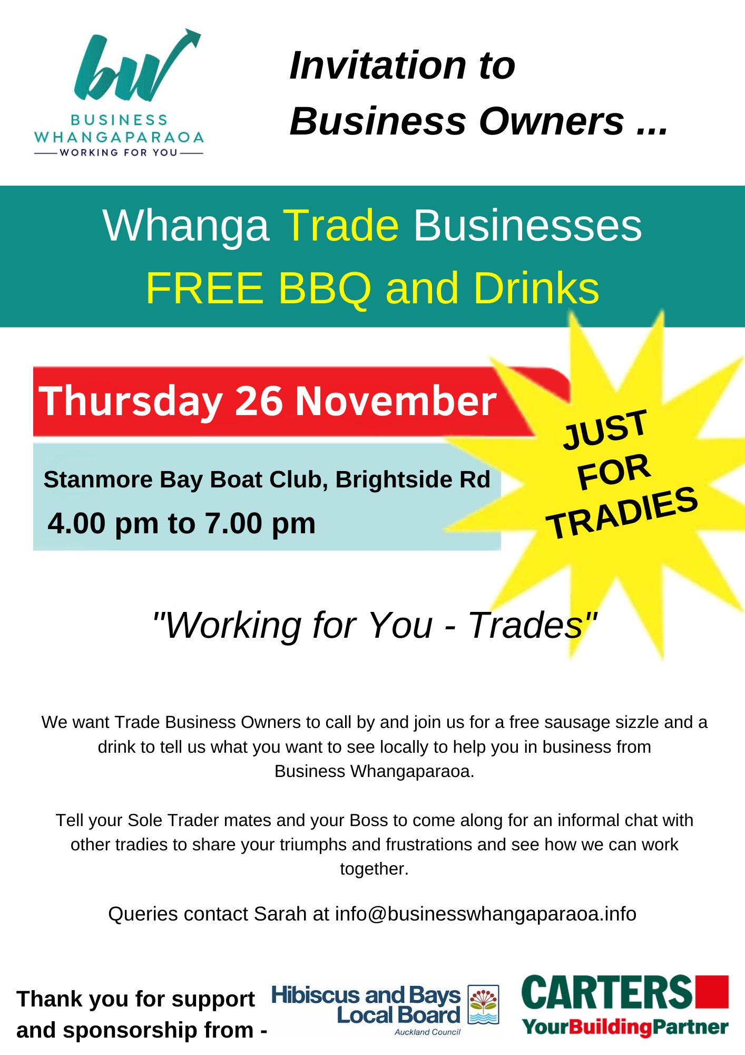
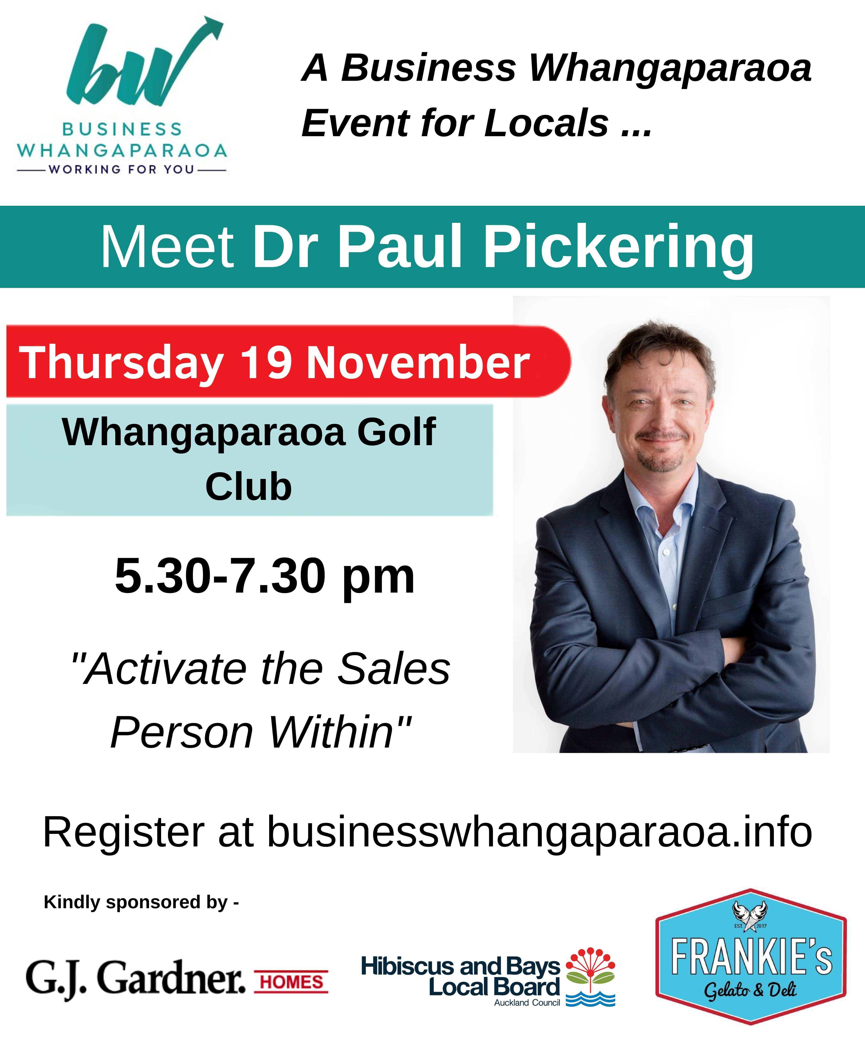
Talk of a Marine Market end of October was pushed out to be a larger event around America’s Cup in March 2021.
Events that were finally held in November were our postponed Network and Trade BBQ events

Slide 18
Our main goals are -
Membership growth
Greater financial stability through filling our Sponsorship Opportunities
Continuation of our popular events and new events
Plans for 2021
Notes:
Our main goals are -
Membership growth
Greater financial stability through filling our Sponsorship Opportunities
Continuation of our popular events and new events

Slide 19
EVENTS PLANNED FOR 2021
Quarterly network events
Regular After 5 events showcasing members
Further “Keep it on the Coast” joint campaign with Destination Orewa and Silverdale Business - Winter
Marine, Outdoor and Leisure Festival with Gulf Harbour Marina and Gulf Harbour Yacht Club - October
Mid and End of Year Christmas casual networking and drinks
Continuation of support of useful online webinars, workshops and learning
First network event
Thursday 4 March
Breakfast at Red Beach Surf Lifesaving Club
7.00 to 8.30 am
Notes:
EVENTS PLANNED FOR 2021
Quarterly network events
Regular After 5 events showcasing members
Further “Keep it on the Coast” joint campaign with Destination Orewa and Silverdale Business - Winter
Marine, Outdoor and Leisure Festival with Gulf Harbour Marina and Gulf Harbour Yacht Club - October
Mid and End of Year Christmas casual networking and drinks
Continuation of support of useful online webinars, workshops and learning

Slide 20
THANK YOU!
Business Whangaparaoa would like to thank our Local Board for your on-going support in what have been difficult times in 2020.
Notes:
THANK YOU!
Business Whangaparaoa would like to thank our Local Board for your on-going support in what have been difficult times in 2020.

